Slide 1
Welcome to Cluster 6M
Mrs. Dean, Cluster Leader/Individuals and Societies
Ms. Askew, Language and Literature
Ms. Chambers, Language and Literature
Mrs. Krafft, Mathematics
Mr. Satterwhite, Science
Lanier Middle school
AN INTERNATIONAL BACCALAUREATE WORLD School

Slide 2
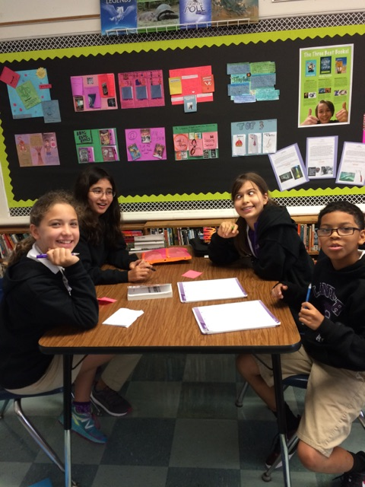
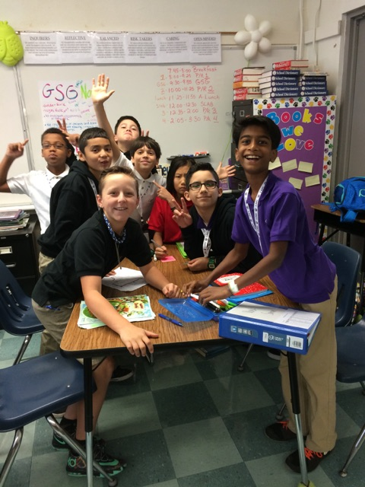
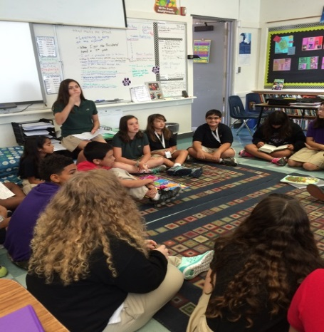
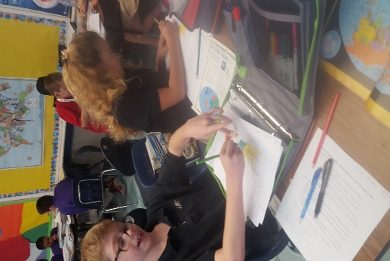
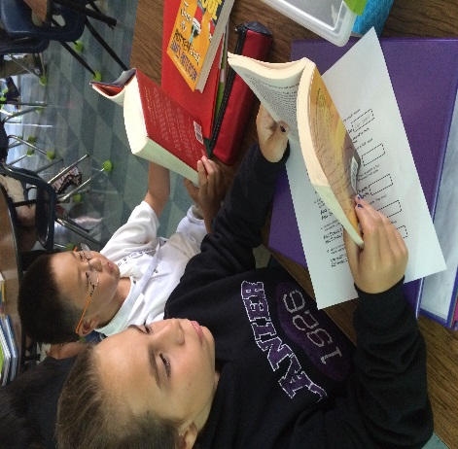
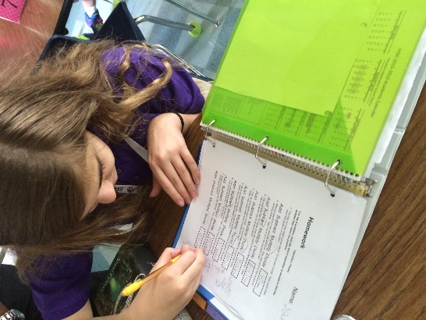
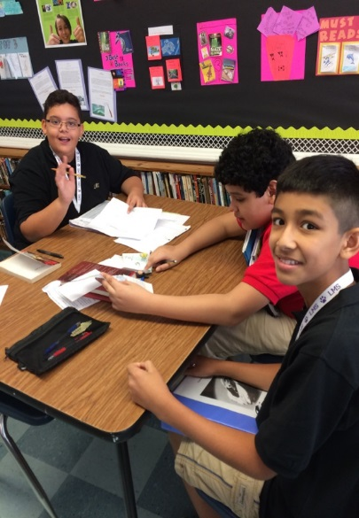
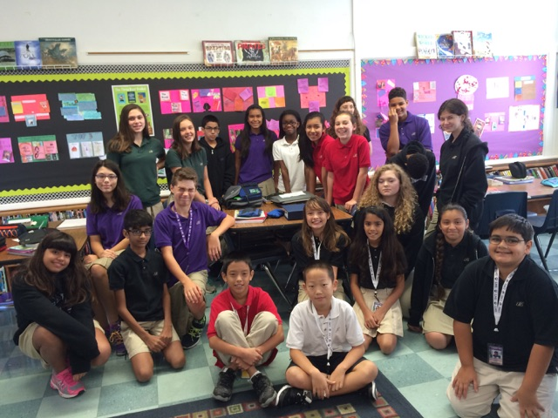
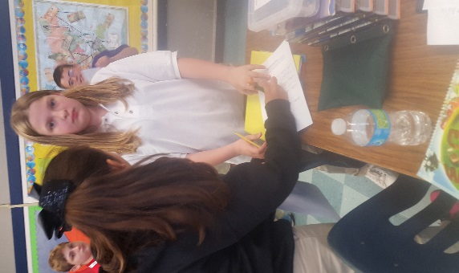
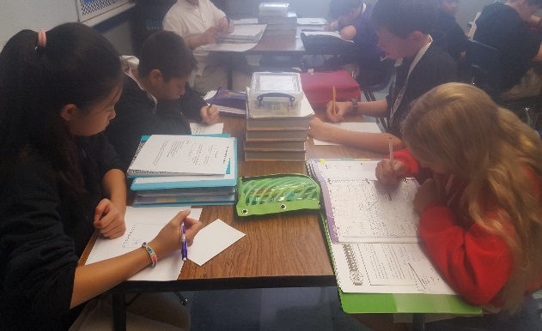
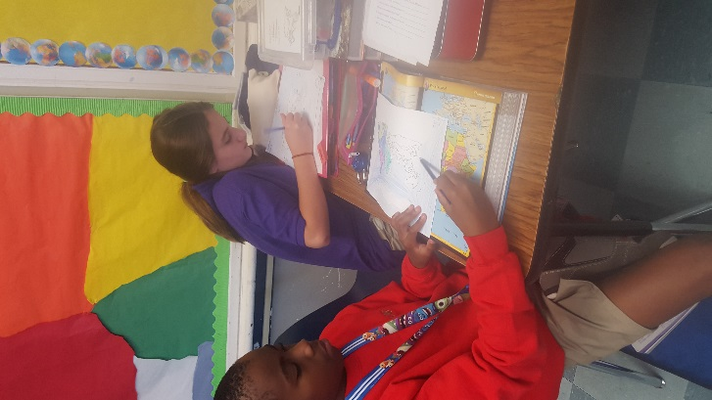
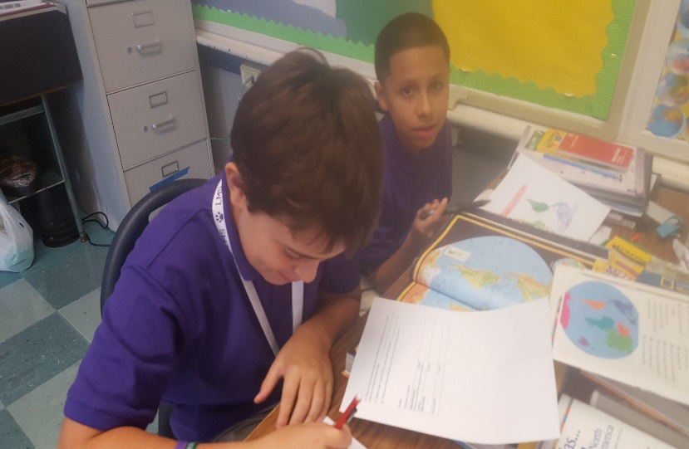
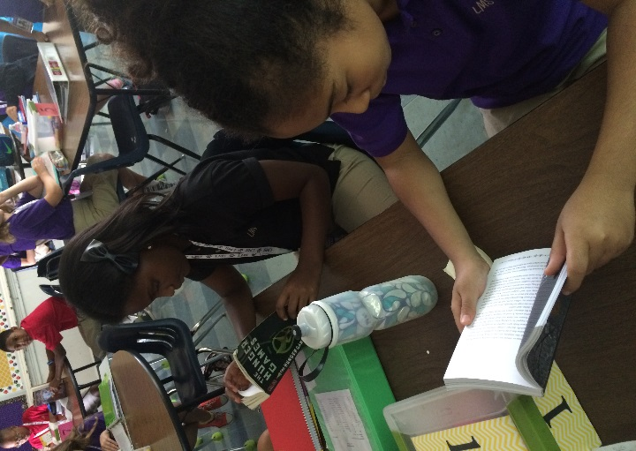
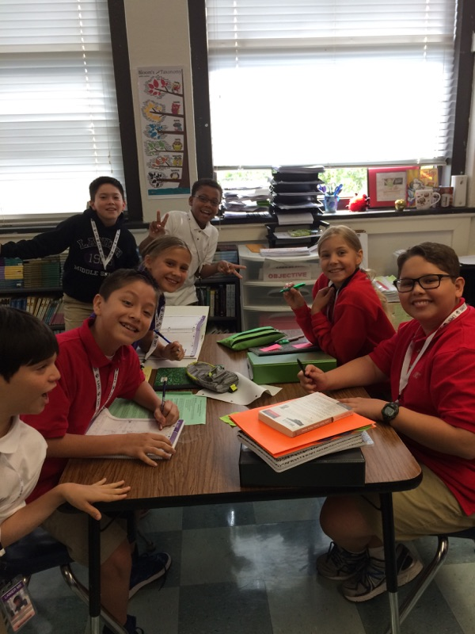
We are so excited to have your child in our Cluster!
Add collage of student pictures…..

Slide 3
Cluster Goals and Expectations
Our aim is to provide the best environment for our students.
Clusters create small learning communities that help teachers and parents better support the student.
Students can expect to receive a rigorous education in all classes in order to prep them for becoming a global graduate. To that end, Clusters provide systems to facilitate all learners.
Notes:
DEAN

Slide 4
IB MYP Programme in Action
The goal of IB is to develop internationally minded students who, recognizing their common humanity and shared guardianship of the planet, help to create a better and more peaceful world.
As part of MYP we will be required to perform some form of community service as a cluster.
All students will be involved in the service activity, so please encourage your child to make it meaningful by fully engaging and contributing.
We are open to ideas and suggestions!
Notes:
SATTERWHITE

Slide 5
Grading System and Policies
Homework: 5-20 points
Classwork: 5-100 points
Quizzes: 25-100 points
Projects/Tests: 50-200 points
IB Grade: 0-8 (weighted at 0)
Objective Testing: 0-100 points (weighted at 0)
Students can retest if they score less than 80% in MS course for up to a 80%
They will have one week to complete the retest.
Notes:
SATTERWHITE

Slide 6
IB Criteria and Grade Report
An IB rubric will be assigned to IB projects and activities
Each subject has four assigned IB criteria
Each subject will report out grades using the four criteria rubrics
Rubrics will be sent home and the IB grade will be posted on Gradespeed (Parent- Connect)
Notes:
SATTERWHITE

Slide 7
Late Work Policies
Work that is not completed by the start of class.
Will be accepted for 5 calendar days after due date.
Days Late..
Day 1: 20% penalty
Day 2: 30% penalty
Day 3-5: 50% penalty
Notes:
KRAFFT

Slide 8
Make-Up Work Policy
Students who are absent will be given the opportunity to make up missing assignments.
The number of days afforded for make-up work will be equal to the number of days absent.
Student is responsible for obtaining and submitting missed assignments.
Contact the Cluster leader if a student is out for multiple days.
Notes:
KRAFFT

Slide 9
Intervention Schedule and Policies
Students in need of intervention will be identified based data from assessed curriculum.
Parents will be notified if a student has been requested to attend intervention.
Students should be on time and ready to work!
Teacher | Subject | Day of the Week/Time
Mrs. Dean | WCS | Mondays, 3:30-4:15
Mrs. Krafft | Math | Tuesdays, 3:30-4:15
Mr. Satterwhite | Science | Wednesdays, 3:30-4:15
Ms. Askew/Chambers | Literacy | Thursdays, 3:30-4:15
Notes:
KRAFFT

Slide 10
Academic Honesty Policy
Lanier Middle School has a long history of high academic achievement. Lanier’s long-standing motto, “Achievement with Honor”, exemplifies the high academic standards and virtues that are so closely intertwined in a place of learning.
Academic dishonesty is defined in The Code of Student Conduct as, “cheating, plagiarism, or copying the work of students.” In the event a student takes part in one or more acts of academic dishonesty he/she will incur consequences as follows:
1st Offense: Zero (0) on academic work, parent contact
2nd Offense: Zero (0) on academic work, parent conference; In-school suspension (ISSC); Growth plan for Vanguard/GT students
3rd Offense: Zero (0) on academic work , parent conference; ISSC; possible exiting from Vanguard/GT program and/or exclusion from leadership program
Notes:
ASKEW

Slide 11
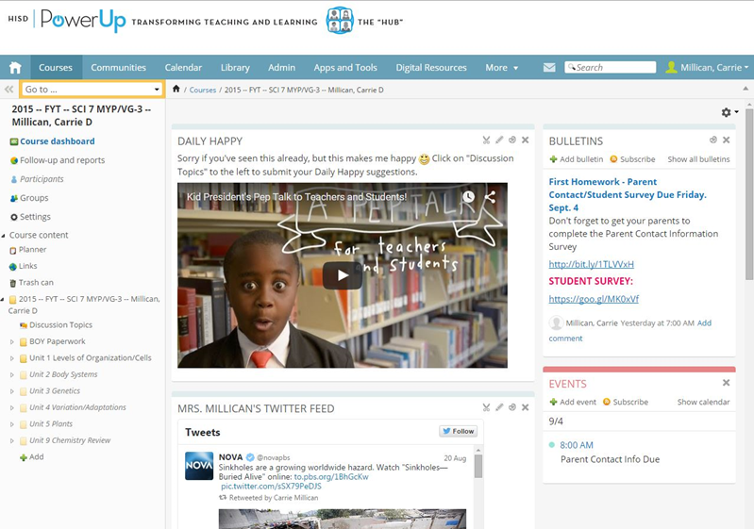
The HUB
The HUB is an online platform that is intended to become the center of collaboration, personalization, curriculum, instruction, and communication for all HISD staff, students, and parents.
Teacher can post assignments, class updates, quizzes, and much more for students to access at home.
Students should check the HUB every night to make sure they are aware of assignments for each class.
Notes:
CHAMBERS

Slide 12
BYOD Policies
Students are allowed to use devices for teacher specified objective based activities, to read during study lab/lunch, and for translating purposes.
Device security is the responsibility of the owner.
Inappropriate use or use outside of a BYOD class/time without permission may result in disciplinary action. Any device use outside of the documented curriculum goals of a given classroom is prohibited.
No student is REQUIRED to bring a digital device to class.
Notes:
CHAMBERS

Slide 13
Responsibility Marks
We feel that responsibility is an important trait to nourish in our 6th graders. In all classes students will be responsible for coming to class prepared, following proper format for completing work (heading, neat, quality, and following class procedures. Infractions will affect student conduct grades as follows:
0-3 infractions/class = excellent responsibility/conduct
4-6 infractions/class = satisfactory responsibility/conduct
7+ infractions/class = poor responsibility/conduct
Each infraction will be recorded in your child’s notebook, and we start at zero each nine week cycle. Parents will be notified if their child earns 6 responsibility marks; 7 responsibility marks will result in a half-hour detention before or after school.
There will be incentives each nine weeks for any child with zero infractions. If your child has 0-3 infractions, you can assume he/she is very responsible in our classes. Please congratulate your child and reinforce the importance of responsibility and that it leads to great success in daily life.
Notes:
Add from cluster policy, and conduct chart

Slide 14
Planner Checks
The planner is our most important tool for staying organized, so we it take it seriously awarding as a grade across all cluster courses.
Happens periodically throughout the nine week cycle
Planner checks are grades that cannot be made up.

Slide 15
Planner Check Rubric
 | 5 points | 4 points | 3 points | 2 points | 1 point | 0 points
Boxes labeled | All boxes labeled | 0-4 boxes missing labels | 5-8 boxes missing labels | 9-12 boxes missing labels | 13-16 boxes missing labels | 17+ boxes missing labels
Homework accurately written in core classes | Homework written descriptively for ALL Core classes. | Homework written in all core classes, but too vague. | Missing 0-4 core class homework assignments. | Missing 5-8 core class homework assignments. | Missing 8-12 core class homework assignments. | Less than half the homework is written in core classes.
All boxes filled with information | All boxes filled with relevant information. | 0-4 empty boxes | 5-8 empty boxes | 9-12 empty boxes | 13-16 empty boxes | 17+ empty boxes
Neat/Complete | Easily read/ understood. Organized with no missing pages. | Legible handwriting. Organized. Few missing pages. | Organized but difficult to read handwriting and/or missing pages. | Difficult to read, unorganized and/or missing multiple pages. | Illegible hand writing and/or missing many pages. | Completely disorganized, impossible to read. Missing pages.

Slide 16
MATH
Newsletter- Please make sure that you have seen it for all my policies
Math Notebooks- Students will write notes, vocabulary, classwork and more in this notebook that is standard across all math classes at Lanier
Syllabus: Math curriculum taught this year includes rational numbers, ratios, equations, geometry, statistics and financial literacy
Assignments: Students will have math homework every night- so please be on the look out!
Projects: Students will be completing a few projects throughout the year including one where they will create their own bakery!

Slide 17
LANGUAGE AND LITERATURE
READING NOTEBOOK EXPECTATIONS
READING RESPONSES- 2 per week (at least)
DELICIOUS WORDS- 3 per week
NOTES- must be complete
LOG SHEETS- parent signatures are required every weekend.
POST-ITS- 3 idea post-its per week
Writing entries- 2 per week (at least)
Notes:
ASKEW

Slide 18
Language and Literature
Dates | Reading Units | Inquiry Question | Writing | Inquiry Question
August | Launching the Workshop | How can I become a better reader/writer while building a literacy community? | Launching the Workshop | Why is it important to have structures in a classroom environment?
Sept./Oct. | Personal Narrative | How do readers make connections to others? | Memoir | How do we express the importance of a life-changing moment?
Oct./Nov. | Informational Non-Fiction | How is communication enhanced through organizational patterns/structure? | Feature Articles | How do organizational patterns affect communication?
Dec./Jan. | Fiction- Short Stories (Independent Reading lives) | TBD | Fiction | TBD
Feb./March | Independent Fiction Cont. | TBD | Persuasive Piece | TBD
April | Notice and Note: Modeling the Masters | TBD | Reading like Writers | TBD
May | Finding mentor Poets and Poems | TBD | Creating Poetry | TBD
Notes:
CHAMBERS

Slide 19
SCIENCE
Scope and Sequence
Introduction to Science - Safety & Experimental Design
Chemistry- Matter & Energy
Forces and Motion & Simple Machines
Earth Systems – Geology, the Earth’s Atmosphere & Plate Tectonics
Astronomy - Components of the Solar System
Structures and Functions of Living Things & Ecosystems

Slide 20
SCIENCE
Science Supplies
1 Composition notebook (stays in class)
2 Rolls of paper towels
*Throughout the year we may have need for some small items
for various experiments and activities, but the cost will be
minimal and I will let your know through a note or email.
-Sciencesaurus (optional at this point, but still a great resource)
If you do purchase a Sciencesaurus I strongly suggest buying a
used copy online for around $5 - $10.

Slide 21
SCIENCE
Science Supplies (continued)
Science Textbook (distributed this week)
It is a consumable, meaning you will not have to return it at
the end of the year. This should be at home as well.
Notice will be given if I want assignments out of it. A lab
manual also goes with this text and will be given out at a
later date.
Find all current homework assignments on Lanier’s website
Purplepups.org then on webpage www.houstonisd.org/Domain/4775

Slide 22
INDIVIDUALS AND SOCIETIES
Student notebooks… one per semester
Textbooks are for the classroom only this year.
Exciting Projects for the year:
Religion Trading Cards
Europe-based Instagram page
African Country display

Slide 23
Cluster Needs
Tissue paper
Paper Towels
Composition notebooks
Clorox Wipes
pencils
Filler paper
Scissors (NOT blunt ended scissors)
Scotch tape
Ziploc bags.. Snack or sandwich
Glue sticks
To support and further our educational technology goals, we would GLADLY and ENTHUSIASTICALLY accept:
- Office Supply Gift Cards
- Monetary donations to the cluster (check written out to Lanier with Cluster 6M in the memo

Slide 24
Thank you for coming!
We appreciate you taking time from your busy schedule to come to Open House.
We are looking forward to a productive and engaging year with you and your child.
Please e-mail us directly with any questions you might have.
Do not forget to take all hand-outs home with you, including the cluster wish list ☺!

